Slide 1
Question Answering
What is Question Answering?

Slide 2
Question Answering
One of the oldest NLP tasks (punched card systems in 1961)
Simmons, Klein, McConlogue. 1964. Indexing and Dependency Logic for Answering English Questions. American Documentation 15:30, 196-204

Slide 3
Question Answering: IBM’s Watson
Won Jeopardy on February 16, 2011!
WILLIAM WILKINSON’S
“AN ACCOUNT OF THE PRINCIPALITIES OF WALLACHIA AND MOLDOVIA”
INSPIRED THIS AUTHOR’S
MOST FAMOUS NOVEL
Bram Stoker

Slide 4
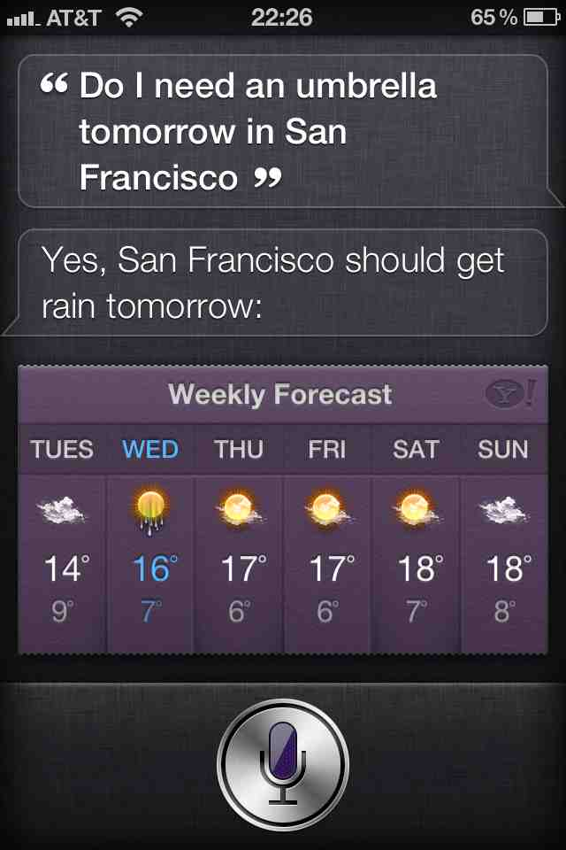
Apple’s Siri

Slide 5
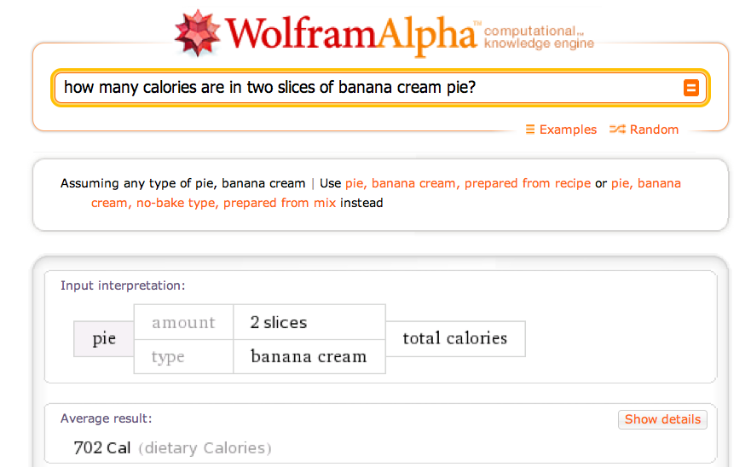
Wolfram Alpha

Slide 6
Types of Questions in Modern Systems
Factoid questions
Who wrote “The Universal Declaration of Human Rights”?
How many calories are there in two slices of apple pie?
What is the average age of the onset of autism?
Where is Apple Computer based?
Complex (narrative) questions:
In children with an acute febrile illness, what is the efficacy of acetaminophen in reducing fever?
What do scholars think about Jefferson’s position on dealing with pirates?

Slide 7
Commercial systems: mainly factoid questions
Where is the Louvre Museum located? | In Paris, France
What’s the abbreviation for limited partnership? | L.P.
What are the names of Odin’s ravens? | Huginn and Muninn
What currency is used in China? | The yuan
What kind of nuts are used in marzipan? | almonds
What instrument does Max Roach play? | drums
What is the telephone number for Stanford University? | 650-723-2300

Slide 8
Paradigms for QA
IR-based approaches
TREC; IBM Watson; Google
Knowledge-based and Hybrid approaches
IBM Watson; Apple Siri; Wolfram Alpha; True Knowledge Evi

Slide 9
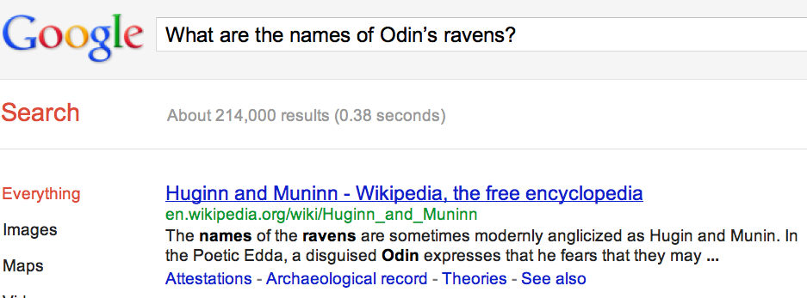
Many questions can already be answered by web search
a

Slide 10
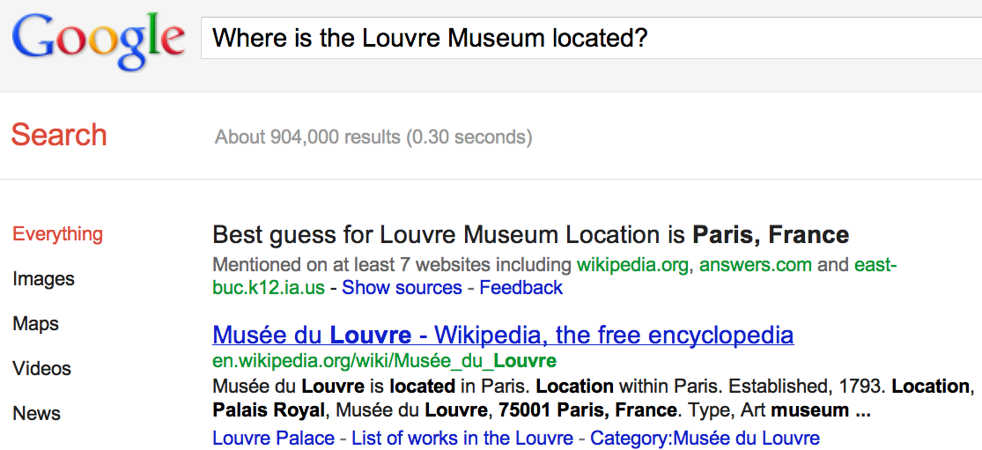
IR-based Question Answering
a

Slide 11
IR-based Factoid QA

Slide 12
IR-based Factoid QA
QUESTION PROCESSING
Detect question type, answer type, focus, relations
Formulate queries to send to a search engine
PASSAGE RETRIEVAL
Retrieve ranked documents
Break into suitable passages and rerank
ANSWER PROCESSING
Extract candidate answers
Rank candidates
using evidence from the text and external sources

Slide 13
Knowledge-based approaches (Siri)
Build a semantic representation of the query
Times, dates, locations, entities, numeric quantities
Map from this semantics to query structured data or resources
Geospatial databases
Ontologies (Wikipedia infoboxes, dbPedia, WordNet, Yago)
Restaurant review sources and reservation services
Scientific databases

Slide 14
Hybrid approaches (IBM Watson)
Build a shallow semantic representation of the query
Generate answer candidates using IR methods
Augmented with ontologies and semi-structured data
Score each candidate using richer knowledge sources
Geospatial databases
Temporal reasoning
Taxonomical classification

Slide 15
Question Answering
What is Question Answering?

